Slide 1
Week 3 Tutorial
Forecasting Financial Performance
Zirui Song
^{March 2025}

Slide 2
Agenda
6-1
6-8
6-10
6-12
6-13
6-14

Slide 3
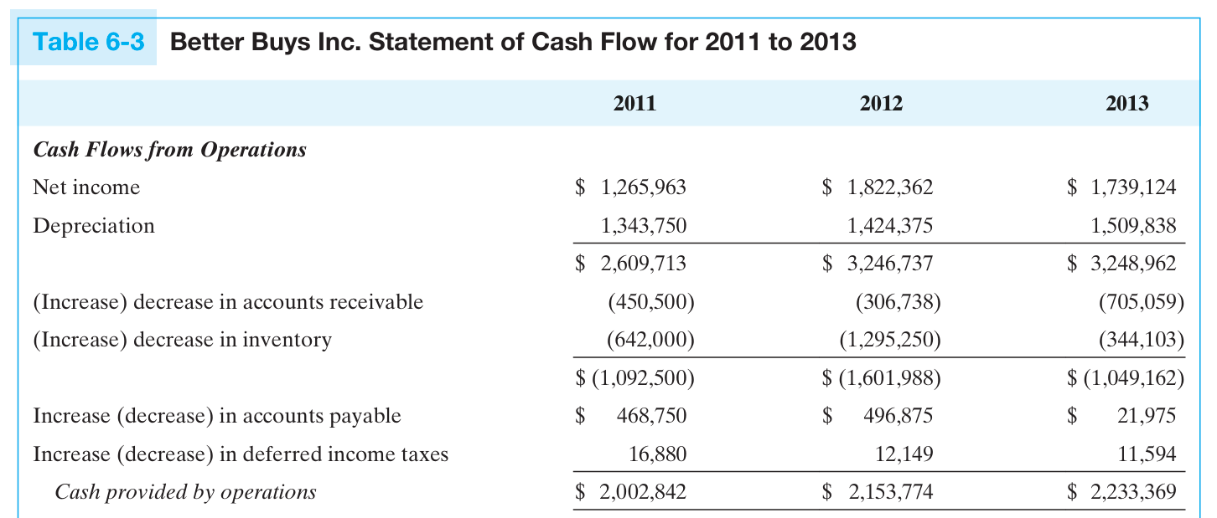


Knowledge review 1: CPBO vs. FCF
aka Cash provided by operations (CPBO)
$$Non−cash$$
$$∆NWC$$
Source: Essential Textbook, Page 199

Slide 4
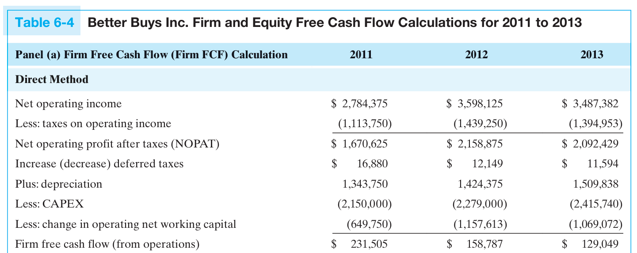
Knowledge review 1: CPBO vs. FCF
Source: Essential Textbook, Page 201

Slide 5
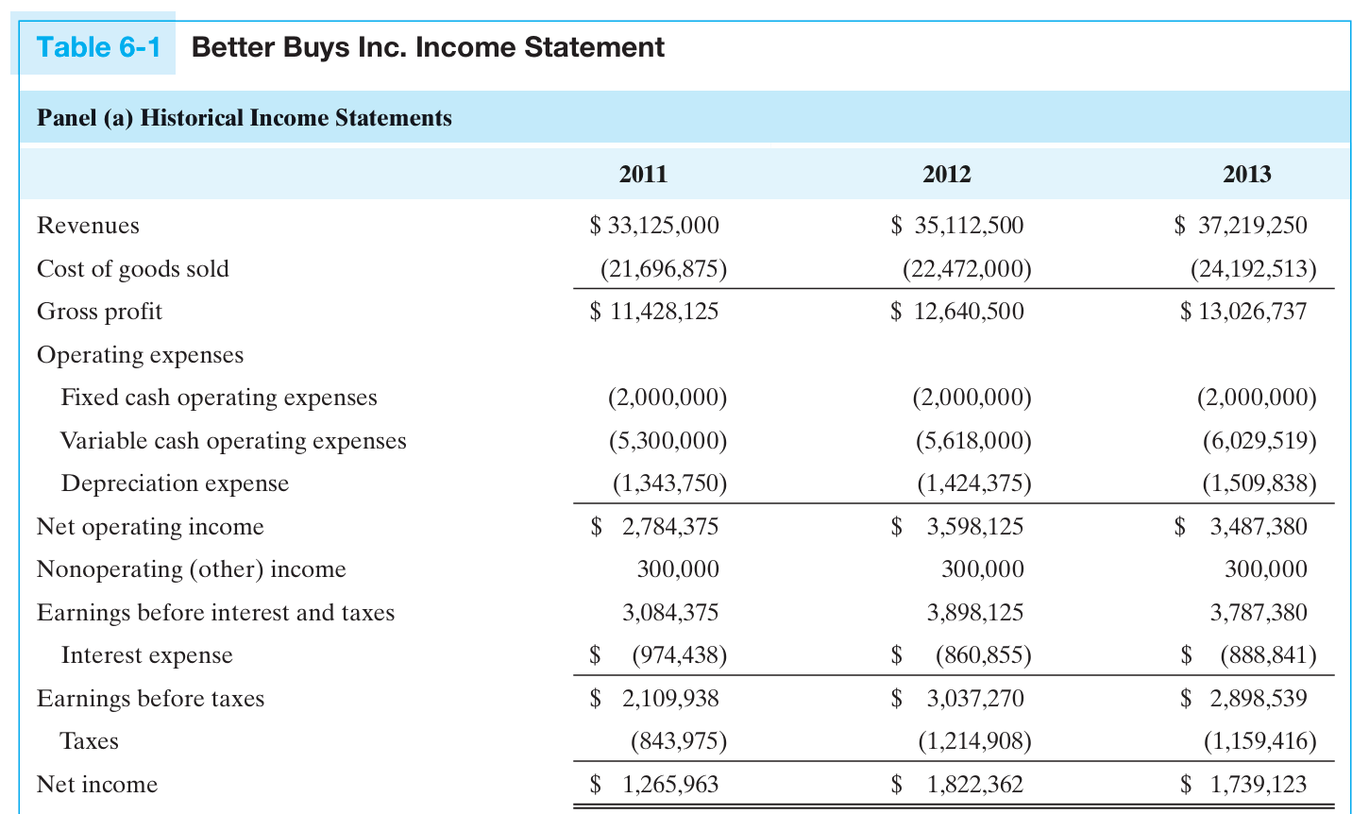
Knowledge review 1: CPBO vs. FCF
(b)
Source: Essential Textbook, Page 190

Slide 6
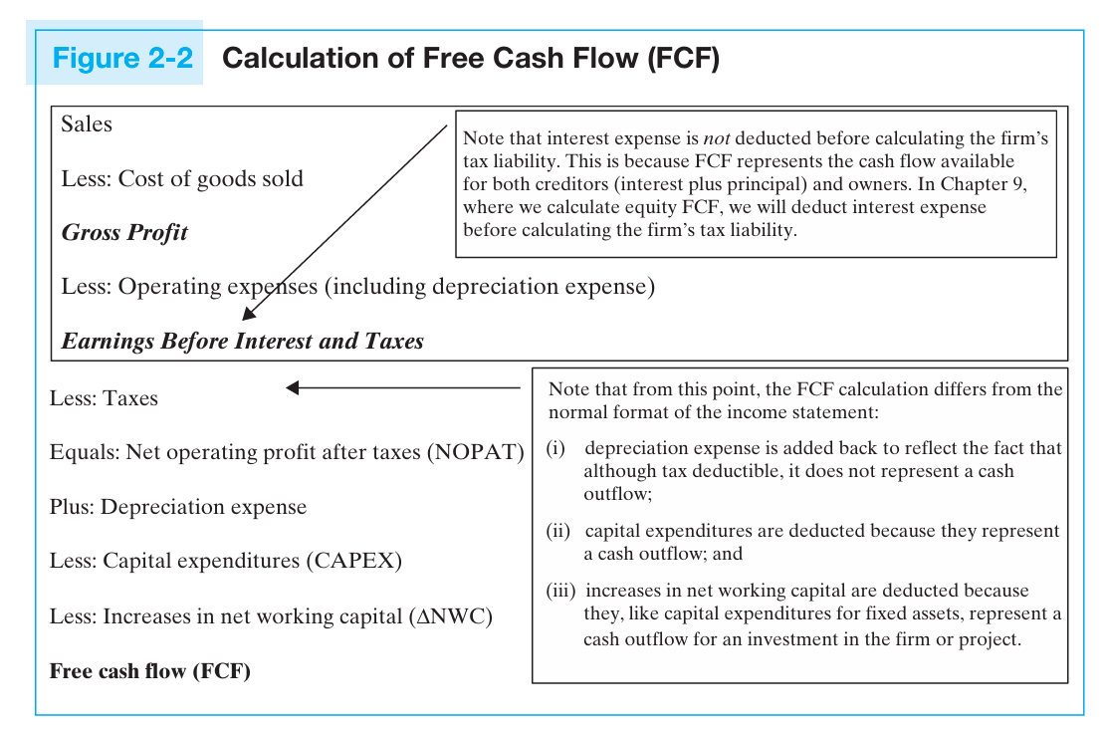
Knowledge review 1: CPBO vs. FCF
Source: Essential Textbook, Page 25

Slide 7
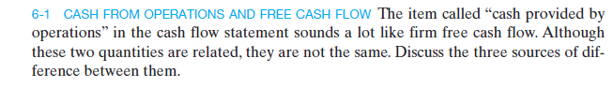
Question 1

Slide 8
Question 1 (cont.)
Answer
Cash provided by operations (CPBO) differs from free cash flow (FCF) for the following reasons:
1. CPBO is measured after subtracting after-tax interest expense.
2. CPBO includes after-tax nonoperating or other income.
3. CPBO excludes consideration for capital expenditures.

Slide 9
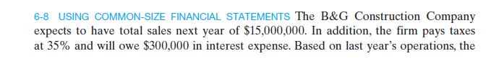
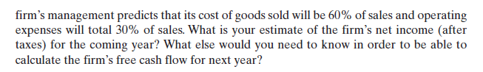
Question 2

Slide 10
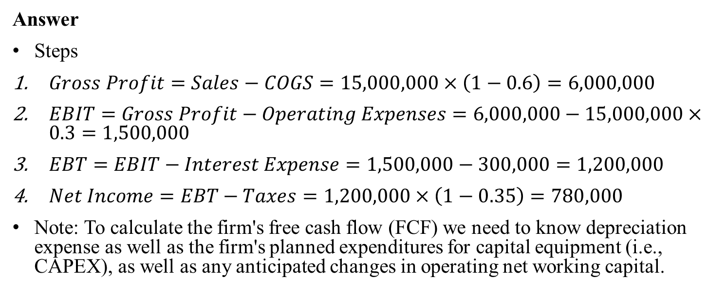
Question 2
Answer
Steps
$Gross Profit=Sales−COGS=15,000,000×\left(1−0.6\right)=6,000,000$
$EBIT=Gross Profit−Operating Expenses=6,000,000−15,000,000×0.3=1,500,000$
$EBT=EBIT−Interest Expense=1,500,000−300,000=1,200,000$
$Net Income=EBT−Taxes=1,200,000×\left(1−0.35\right)=780,000$
Note: To calculate the firm's free cash flow (FCF) we need to know depreciation expense as well as the firm's planned expenditures for capital equipment (i.e., CAPEX), as well as any anticipated changes in operating net working capital.

Slide 11
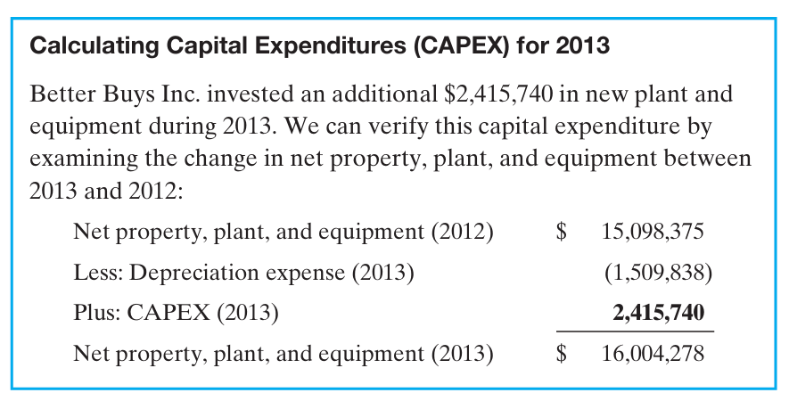
Knowledge review 2: CAPEX
Source: Essential Textbook, Page 199

Slide 12
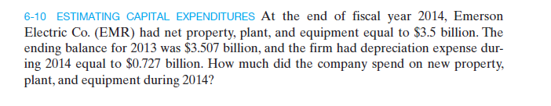
Question 3

Slide 13
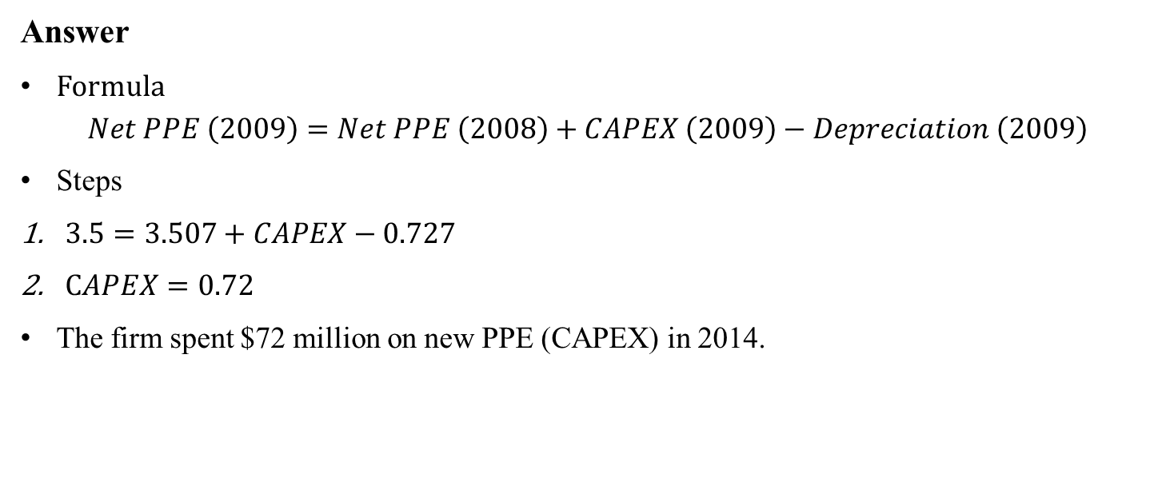
Question 3 (cont.)
Answer
Formula
$$Net PPE \left(2009\right)=Net PPE \left(2008\right)+CAPEX \left(2009\right)−Depreciation \left(2009\right)$$
Steps
$3.5=3.507+CAPEX−0.727$
$CAPEX=0.72$
The firm spent $72 million on new PPE (CAPEX) in 2014.

Slide 14
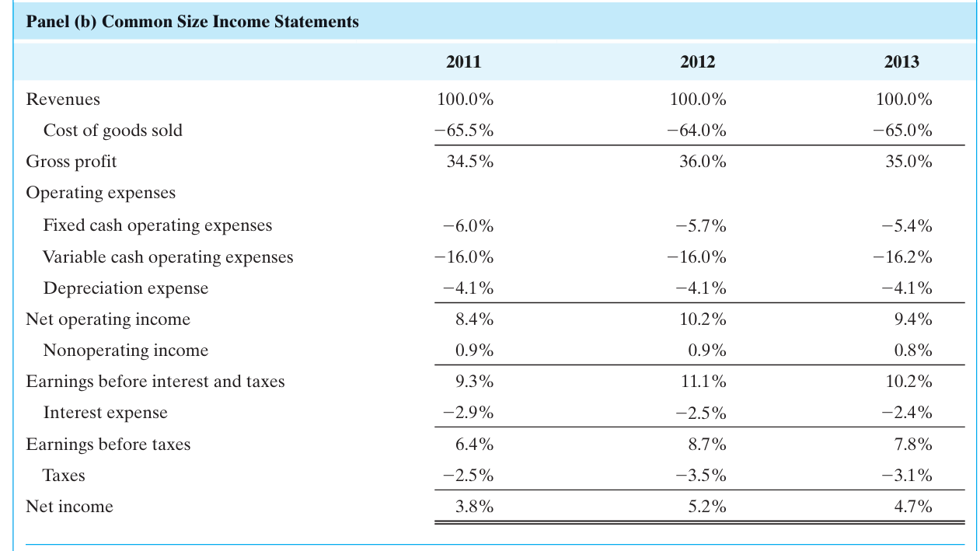
Knowledge review 3: common-size financial statement
(a)
Source: Essential Textbook, Page 190

Slide 15
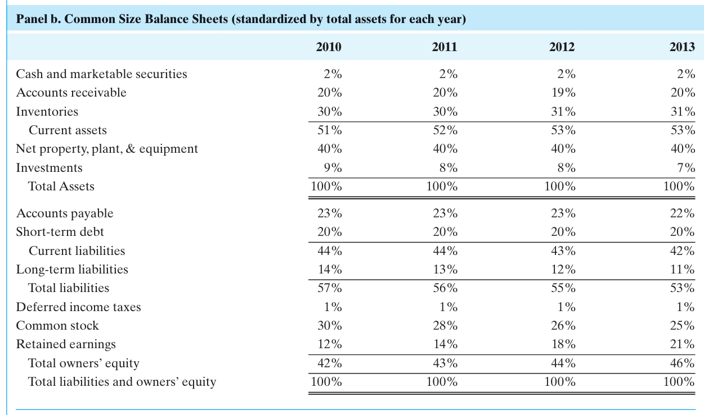
Knowledge review 3: common-size financial statement
Source: Essential Textbook, Page 194

Slide 16
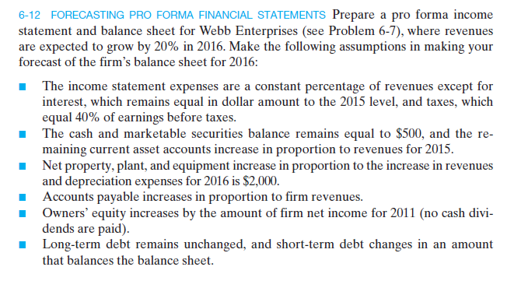
Question 4
typo, 2016

Slide 17
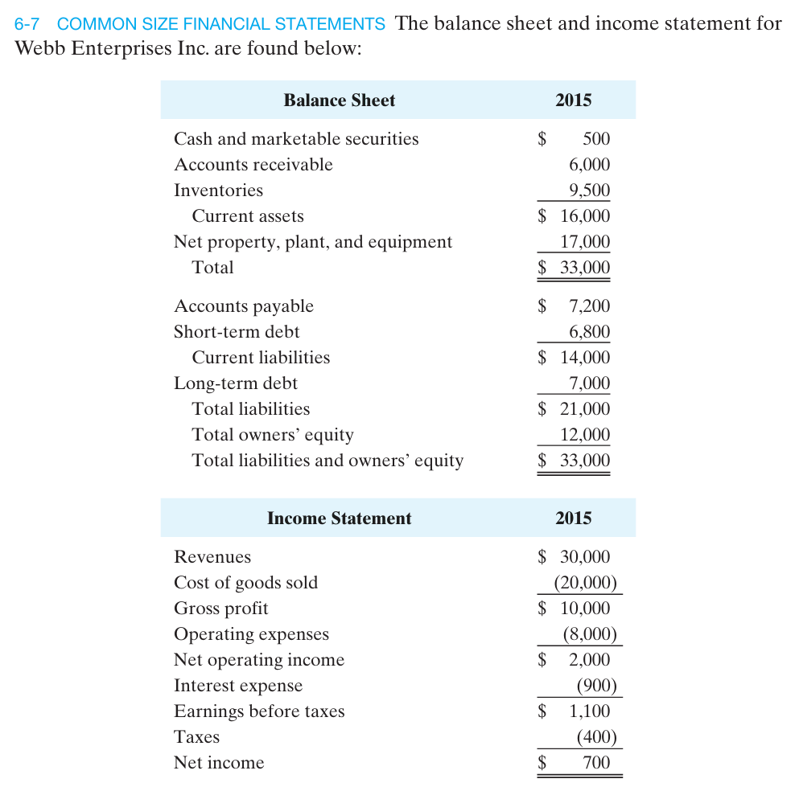
Question 4 (cont.)

Slide 18
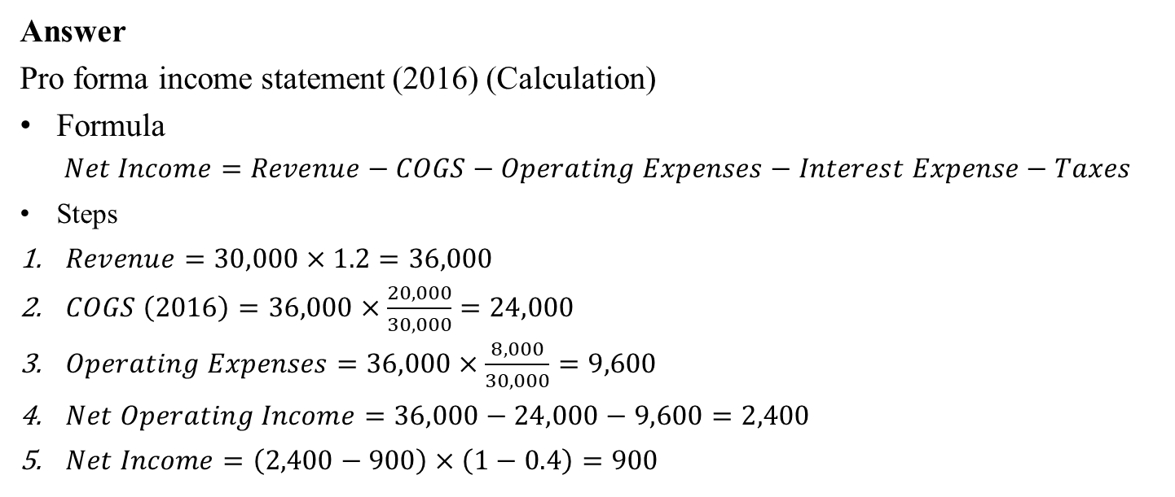
Question 4 (cont.)
Answer
Pro forma income statement (2016) (Calculation)
Formula
$$Net Income=Revenue−COGS−Operating Expenses−Interest Expense−Taxes$$
Steps
$Revenue=30,000×1.2=36,000$
$COGS \left(2016\right)=36,000×\frac{20,000}{30,000}=24,000$
$Operating Expenses=36,000×\frac{8,000}{30,000}=9,600$
$Net Operating Income=36,000−24,000−9,600=2,400$
$Net Income=\left(2,400−900\right)×\left(1−0.4\right)=900$

Slide 19
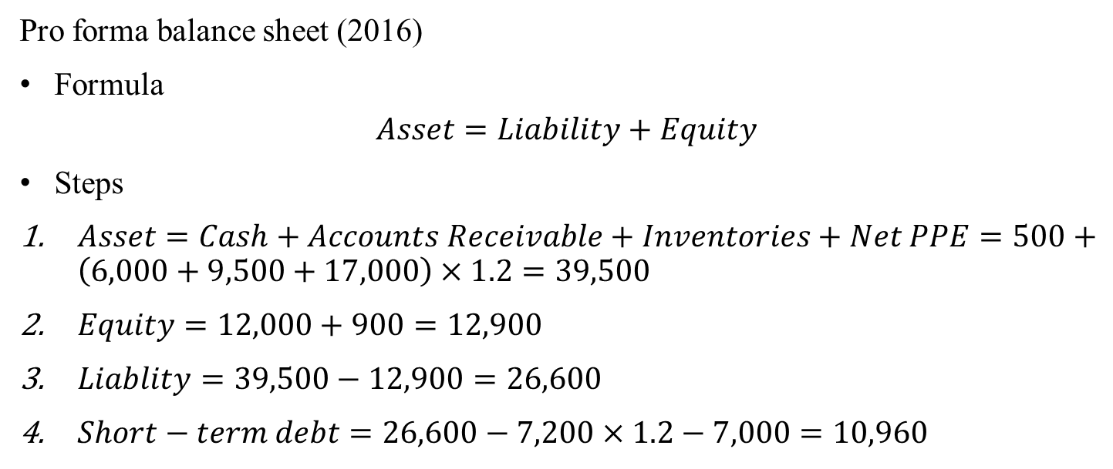
Question 4 (cont.)
Pro forma balance sheet (2016)
Formula
$$Asset=Liability+Equity$$
Steps
$Asset=Cash+Accounts Receivable+Inventories+Net PPE=500+\left(6,000+9,500+17,000\right)×1.2=39,500$
$Equity=12,000+900=12,900$
$Liablity=39,500−12,900=26,600$
$Short−term debt=26,600−7,200×1.2−7,000=10,960$

Slide 20
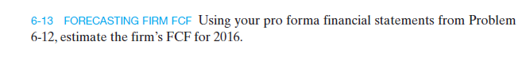
Question 5

Slide 21
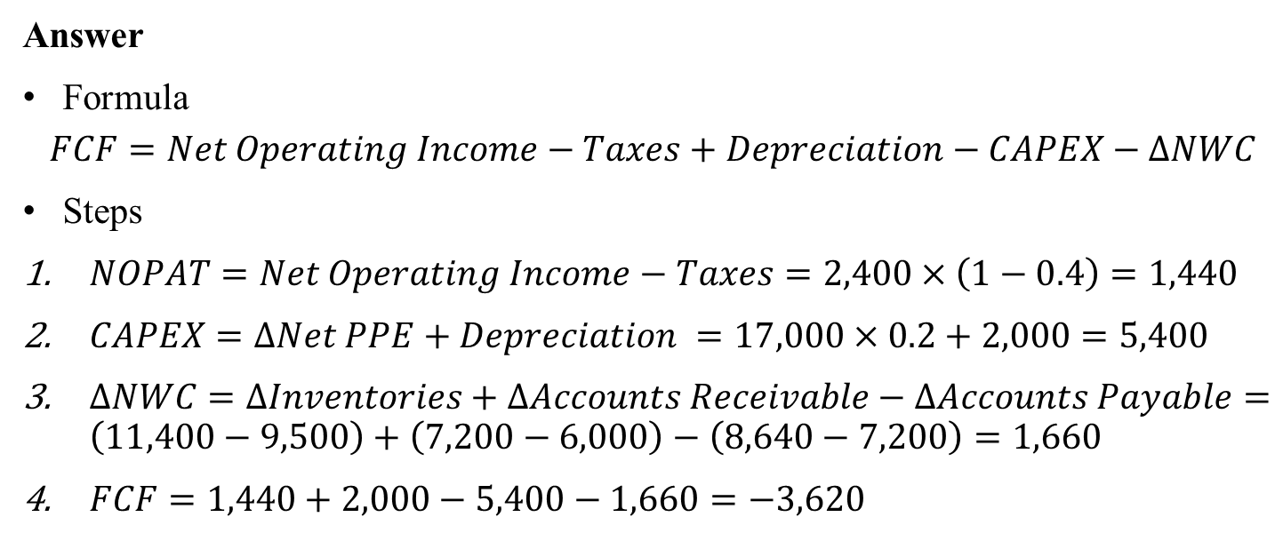
Question 5 (cont.)
Answer
Formula
$$FCF=Net Operating Income−Taxes+Depreciation−CAPEX−∆NWC$$
Steps
$NOPAT=Net Operating Income−Taxes=2,400×\left(1−0.4\right)=1,440$
$CAPEX=∆Net PPE+Depreciation =17,000×0.2+2,000=5,400$
$∆NWC=∆Inventories+∆Accounts Receivable−∆Accounts Payable=\left(11,400−9,500\right)+\left(7,200−6,000\right)−\left(8,640−7,200\right)=1,660$
$FCF=1,440+2,000−5,400−1,660=−3,620$

Slide 22
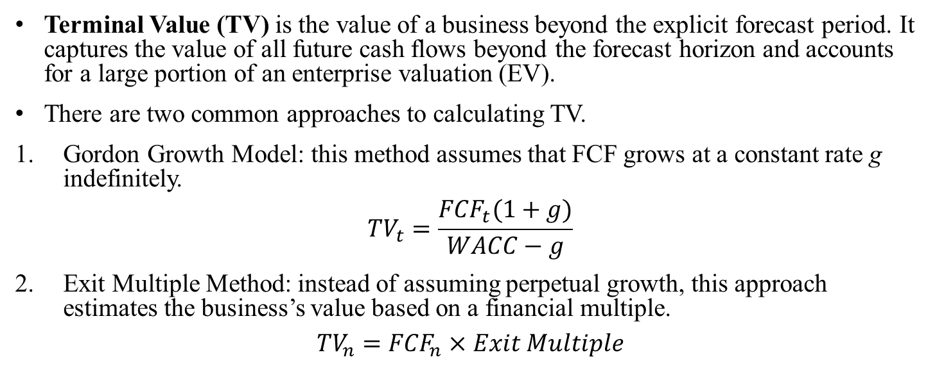
Knowledge review 4: terminal value
Terminal Value (TV) is the value of a business beyond the explicit forecast period. It captures the value of all future cash flows beyond the forecast horizon and accounts for a large portion of an enterprise valuation (EV).
There are two common approaches to calculating TV.
Gordon Growth Model: this method assumes that FCF grows at a constant rate g indefinitely.
$${TV}_{t}=\frac{{FCF}_{t}(1+g)}{WACC−g}$$
Exit Multiple Method: instead of assuming perpetual growth, this approach estimates the business’s value based on a financial multiple.
$${TV}_{n}={FCF}_{n}×Exit Multiple$$

Slide 23
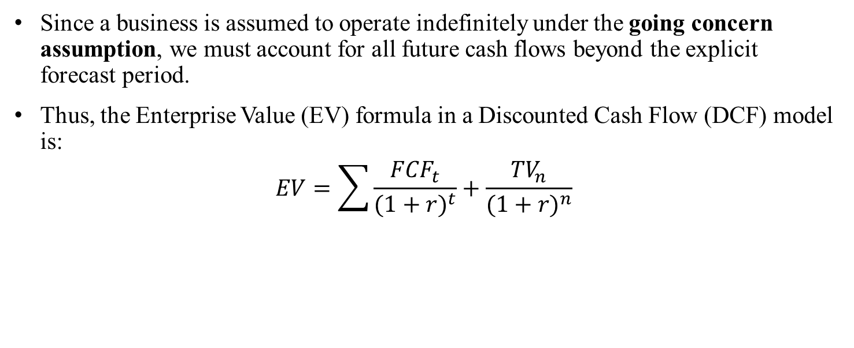
Knowledge review 4: terminal value
Since a business is assumed to operate indefinitely under the going concern assumption, we must account for all future cash flows beyond the explicit forecast period.
Thus, the Enterprise Value (EV) formula in a Discounted Cash Flow (DCF) model is:
$$EV=\sum{\frac{{FCF}_{t}}{{(1+r)}^{t}}+\frac{{TV}_{n}}{{(1+r)}^{n}}}$$

Slide 24
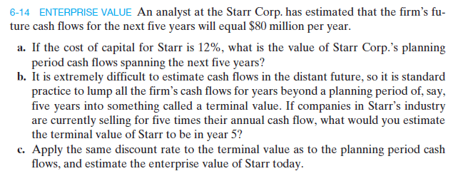
Question 6

Slide 25
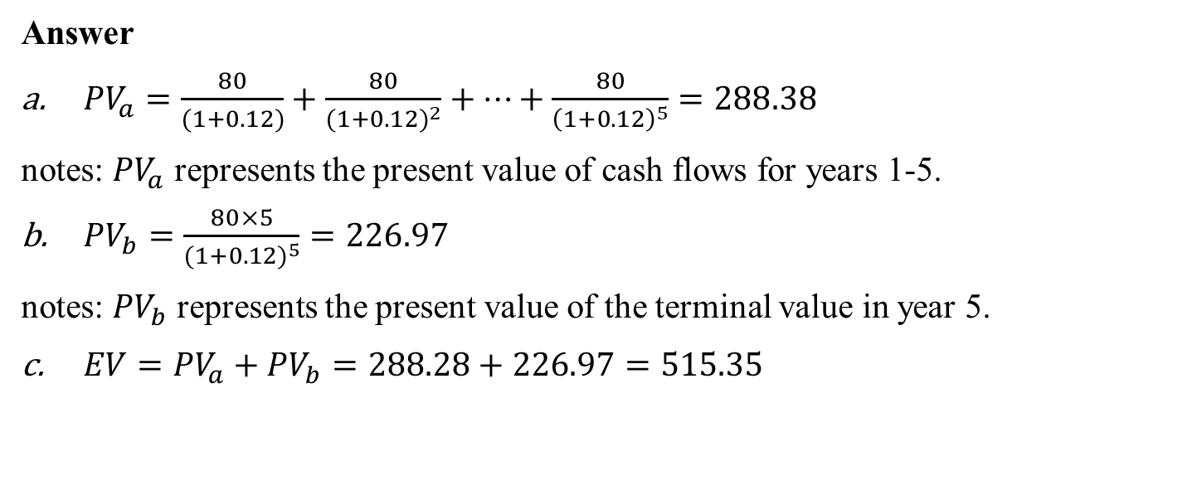
Question 6 (cont.)
Answer
${PV}_{a}=\frac{80}{(1+0.12)}+\frac{80}{{(1+0.12)}^{2}}+…+\frac{80}{{\left(1+0.12\right)}^{5}}=288.38$
notes: ${PV}_{a}$ represents the present value of cash flows for years 1-5.
${PV}_{b}=\frac{80×5}{{(1+0.12)}^{5}}=226.97$
notes: ${PV}_{b}$ represents the present value of the terminal value in year 5.
$EV={PV}_{a}+{PV}_{b}=288.28+226.97=515.35$

